Slide 1
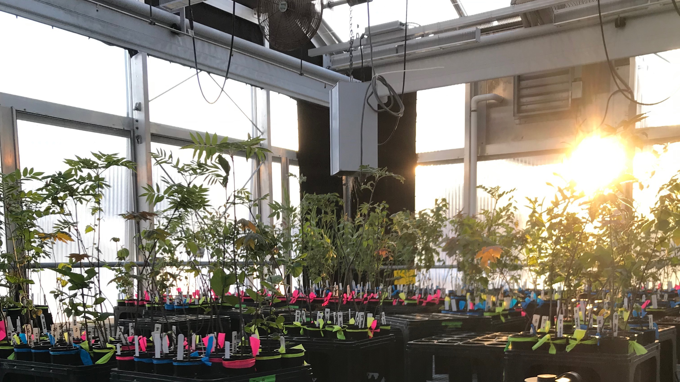
False spring damage on temperate tree seedlings is amplified with winter warming
Cat Chamberlain
Arnold Arboretum – Harvard University

Slide 2

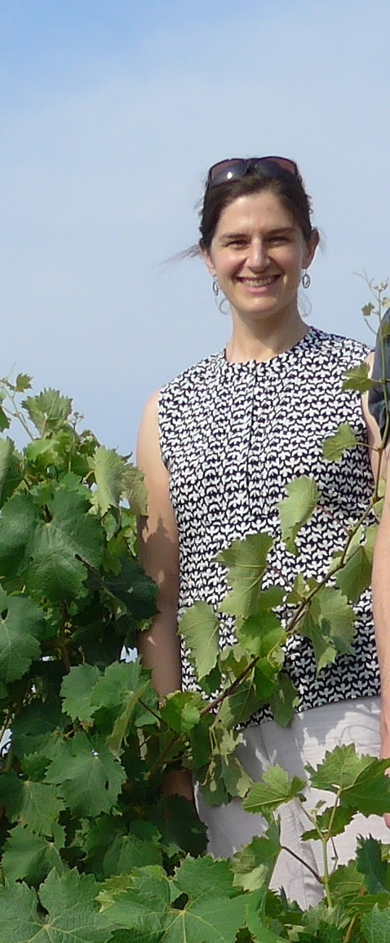
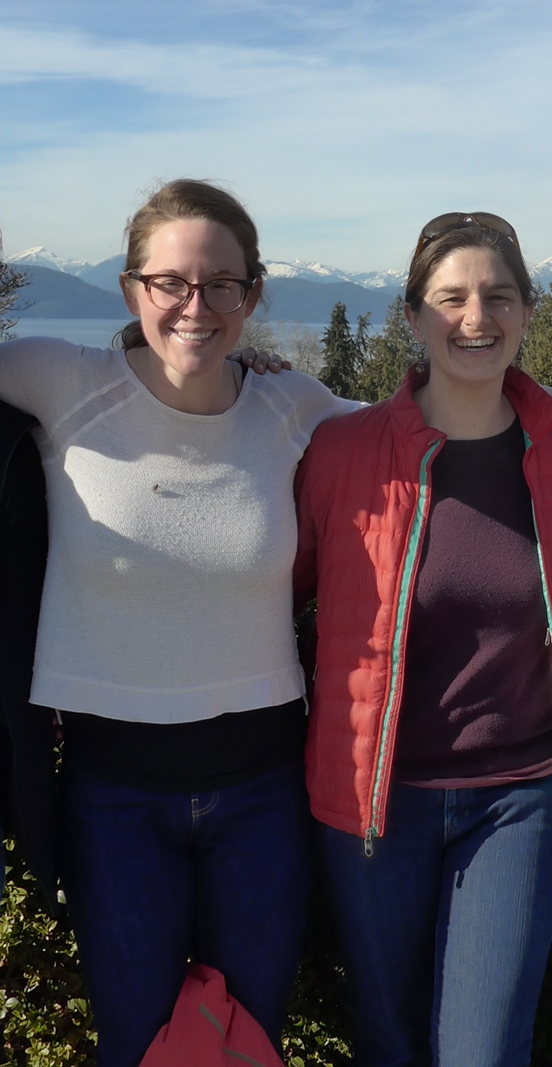
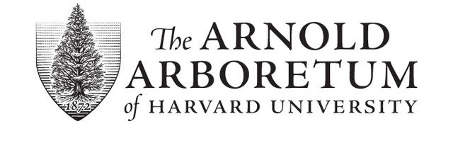
COAUTHORS
Kea Woodruff
Lizzie Wolkovich

Slide 3
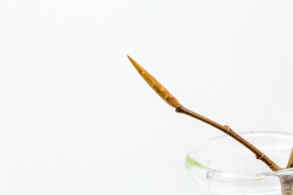
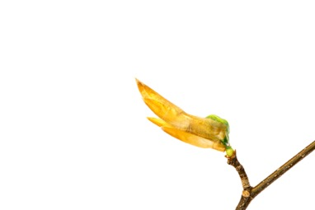
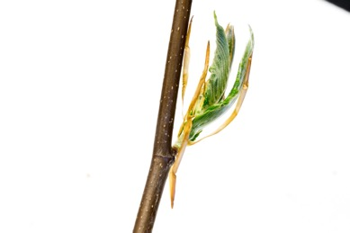
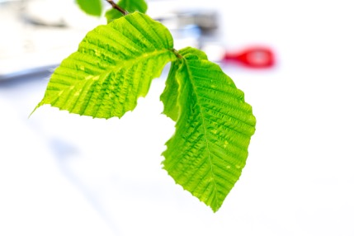
Phenology
American Beech: Fagus sylvatica
DORMANT BUD
BUDBURST
LEAFOUT

Slide 4
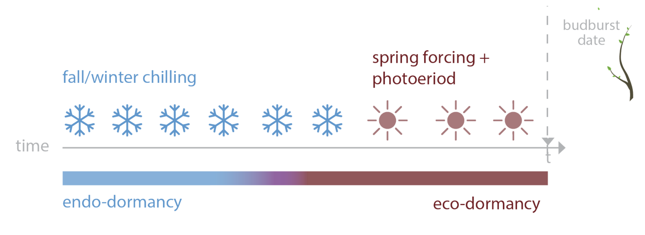
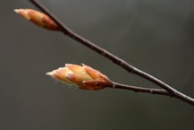
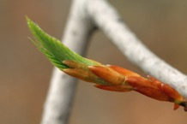
PHENOLOGY USES MULTIPLE CUES
spring warming + daylength
Ettinger, Chamberlain et al, Nature Climate Change 2020

Slide 5
Freeze tolerance
Duration of Vegetative Risk
Chamberlain et al, Global Change Biology 2019

Slide 6
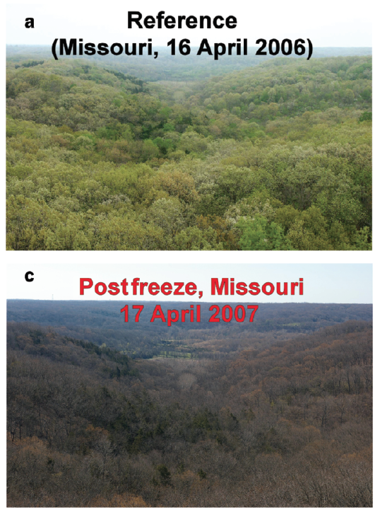
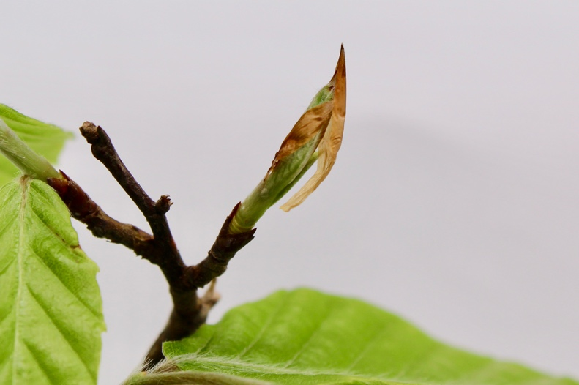
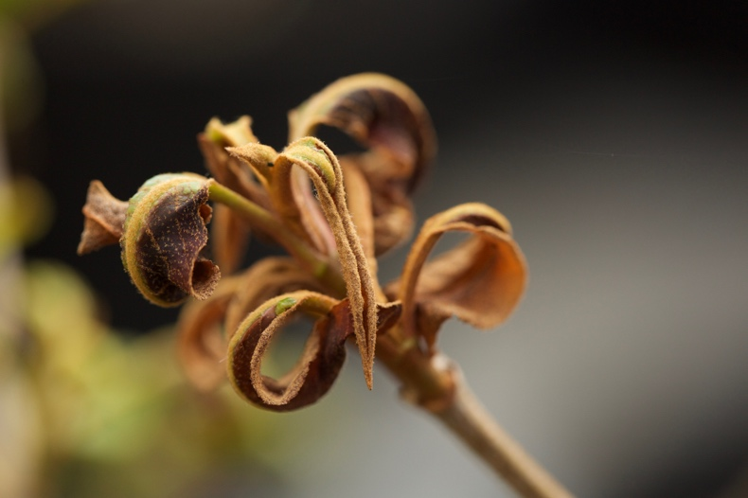
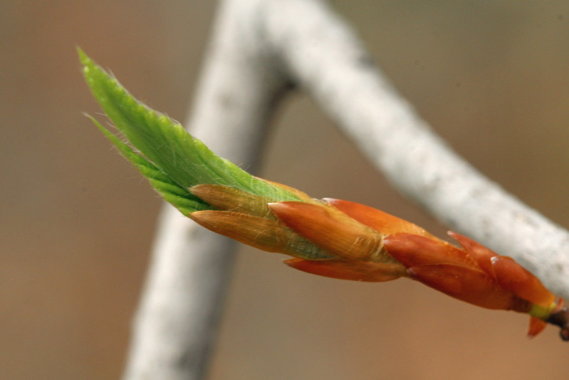
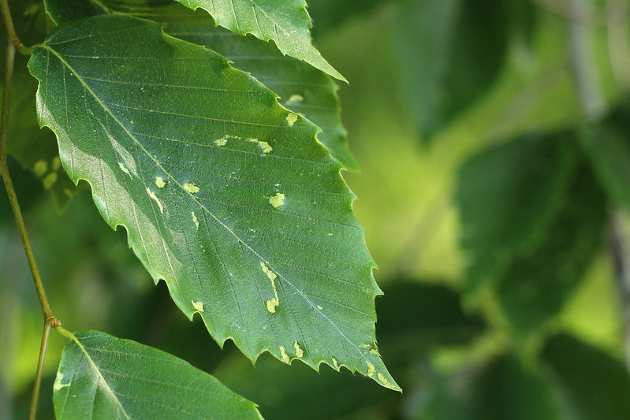
False Spring: freezing temperatures after budburst has initiated
Budburst
Leafout
Gu et al, 2007

Slide 7
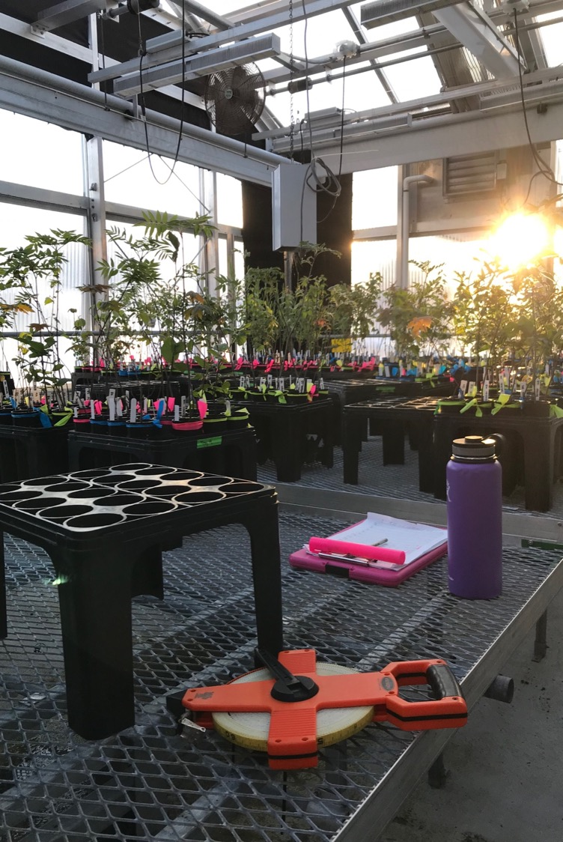
GREENHOUSE EXPERIMENT:
8 NEW ENGLAND TREE SPECIES
3 LEVELS OF OVER-WINTER CHILLING
4 WEEKS
6 WEEKS
8 WEEKS
FALSE SPRING

Slide 8
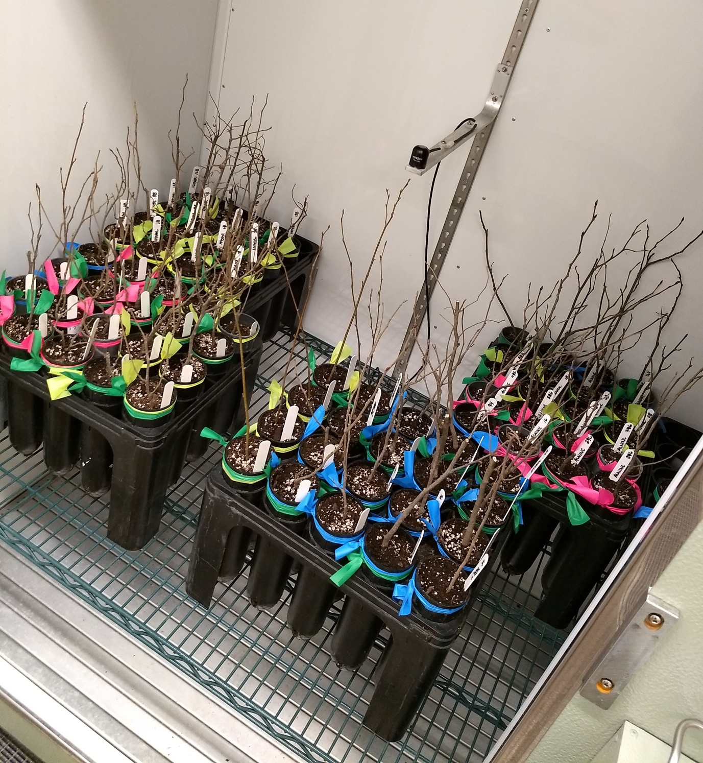
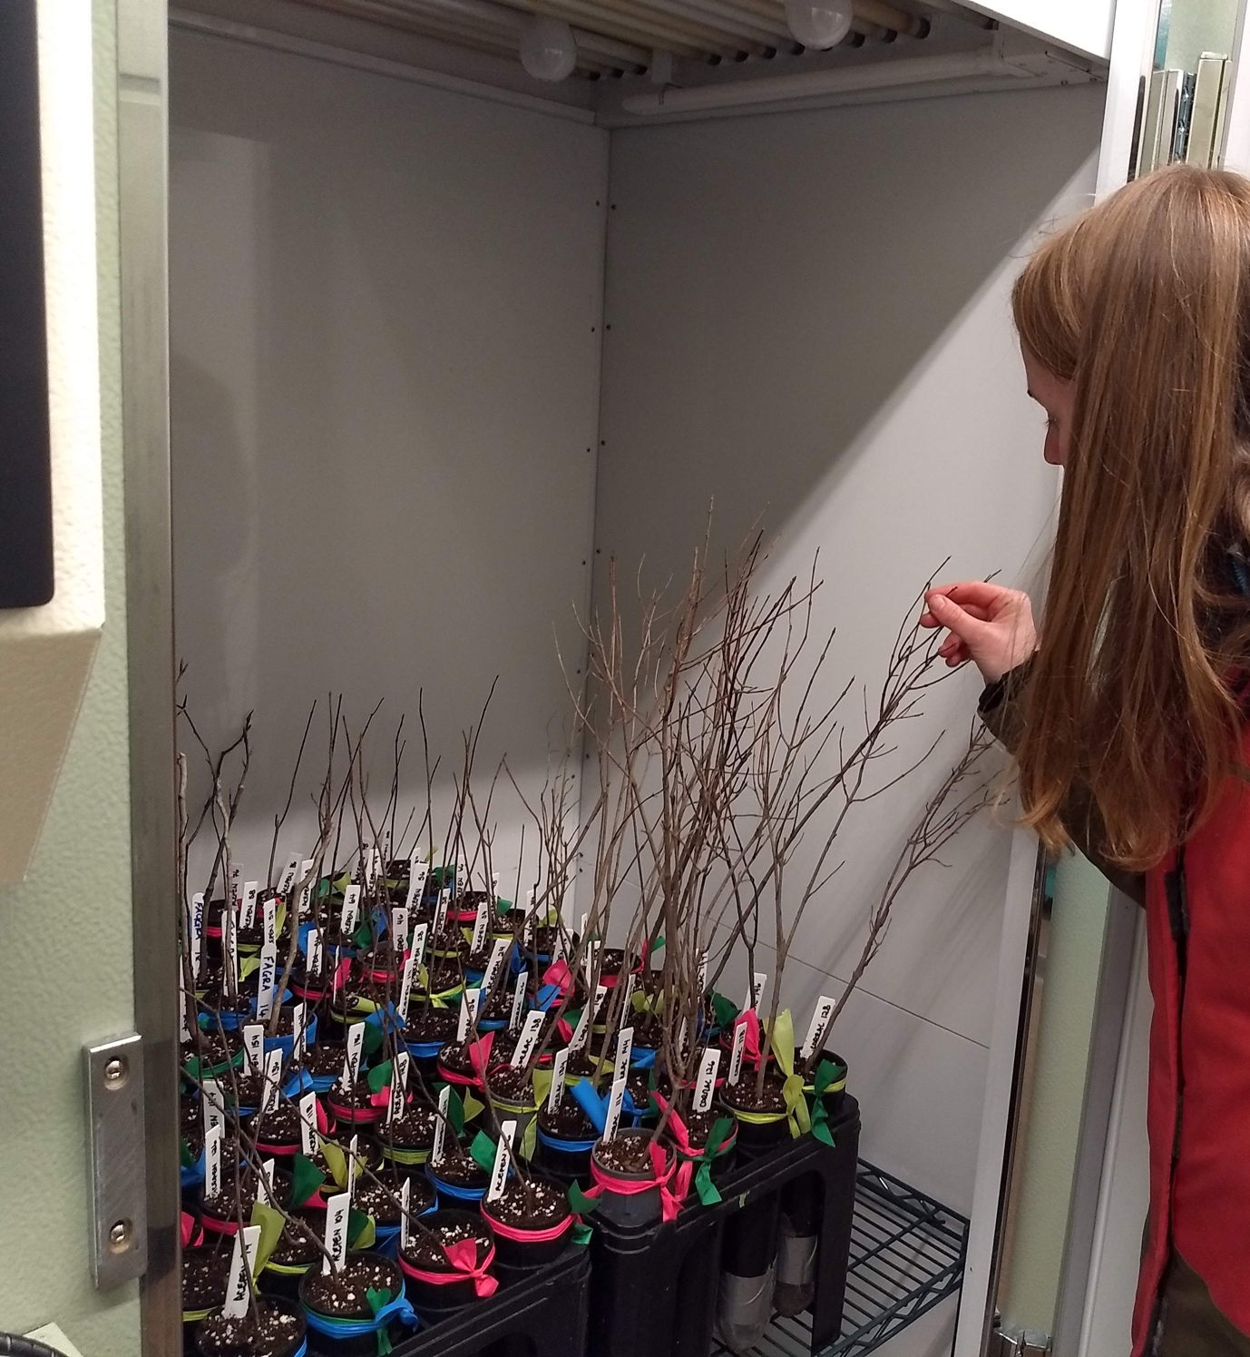

Slide 9
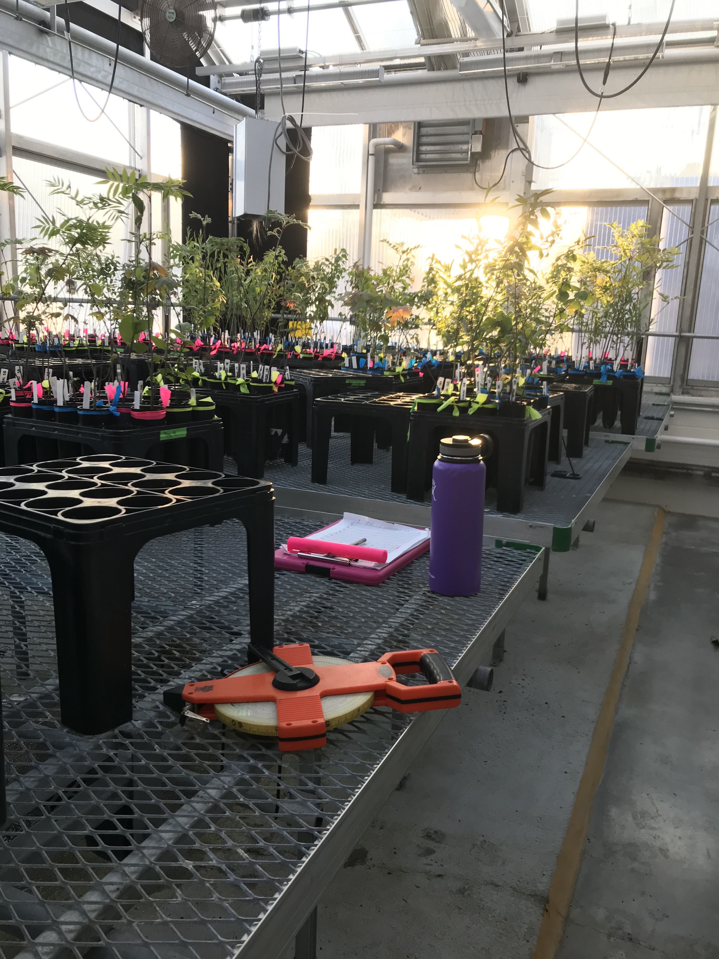

Slide 10
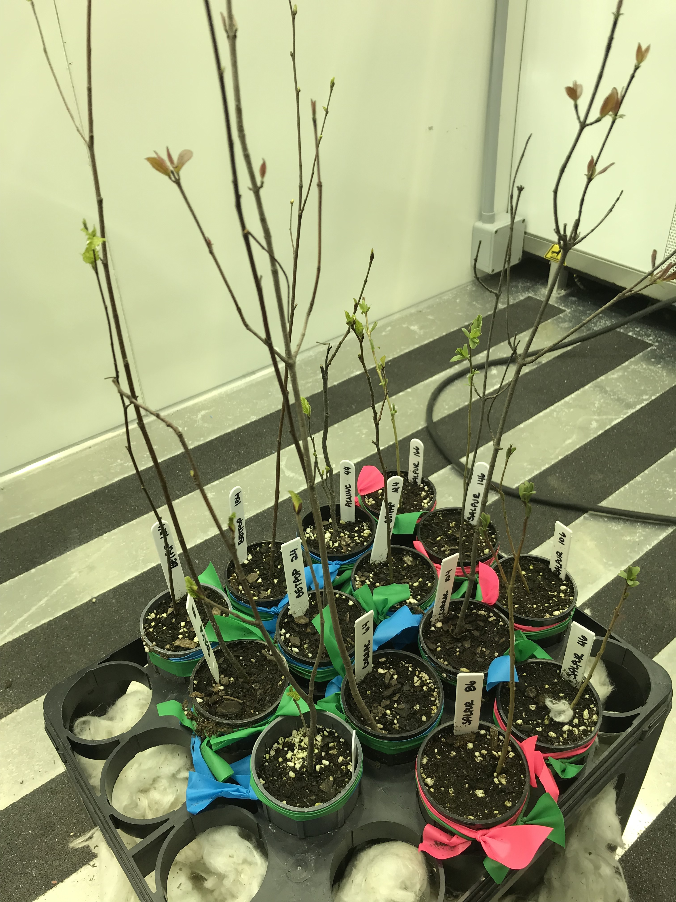
False spring treatment

Slide 11
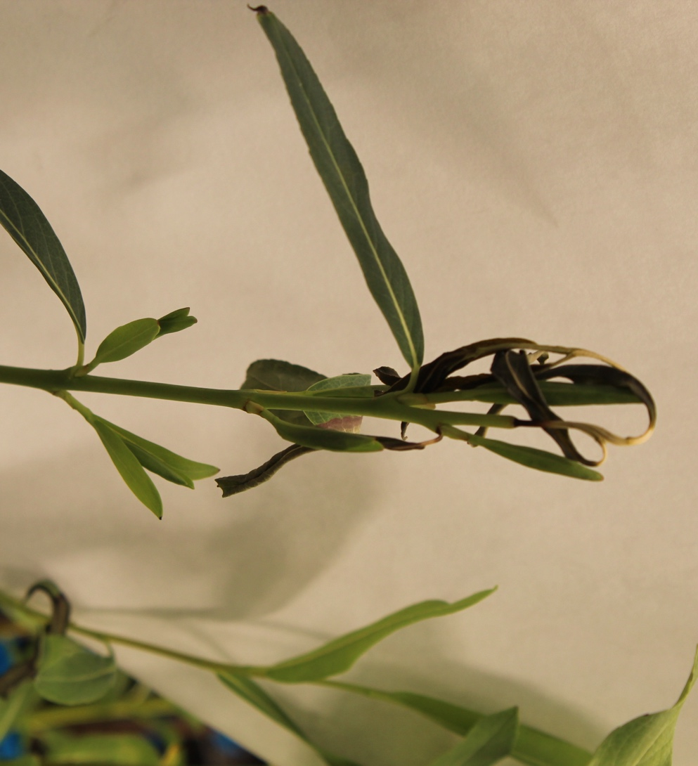
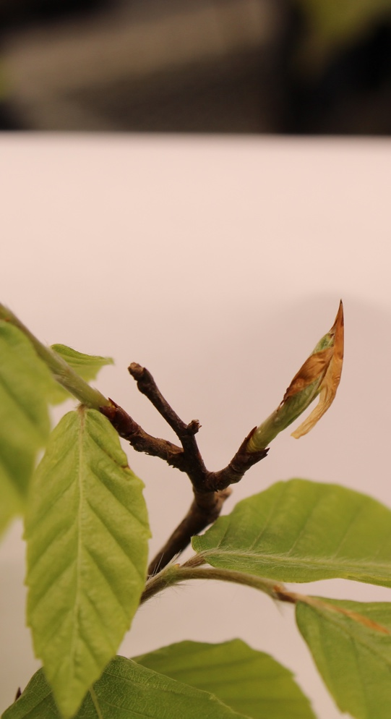
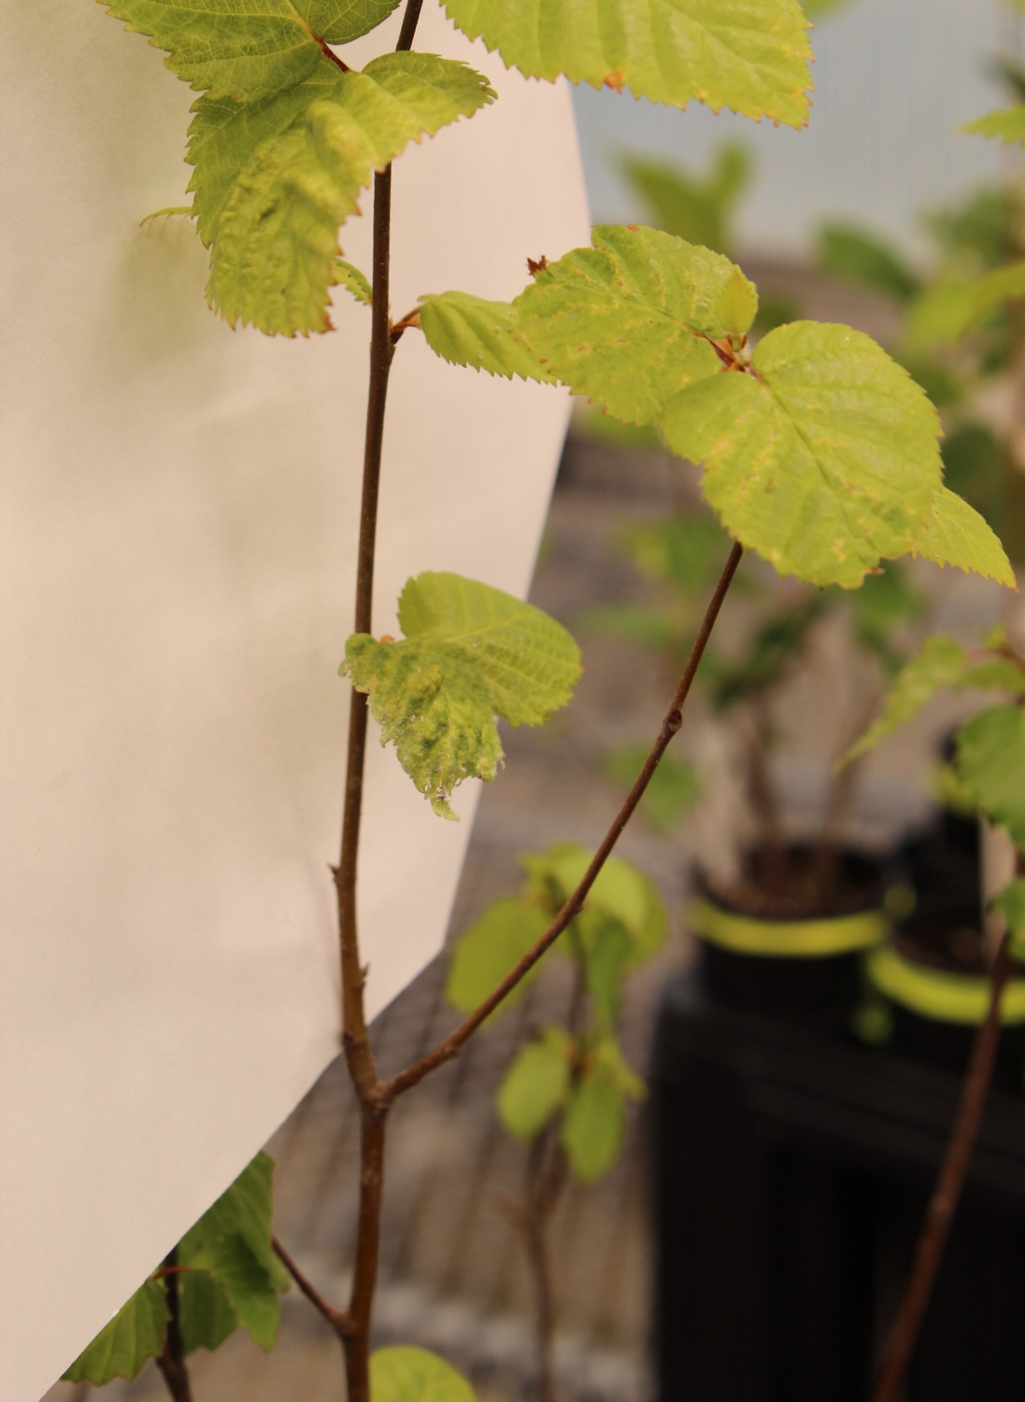
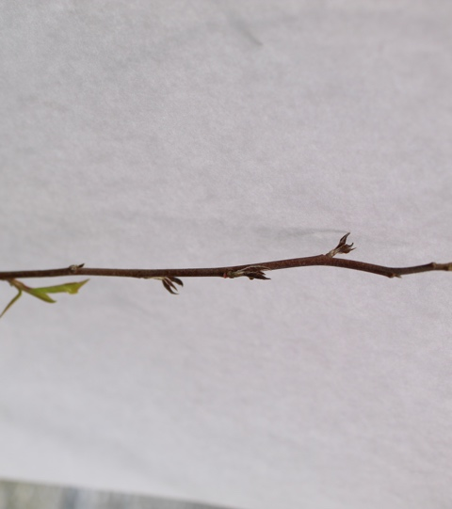
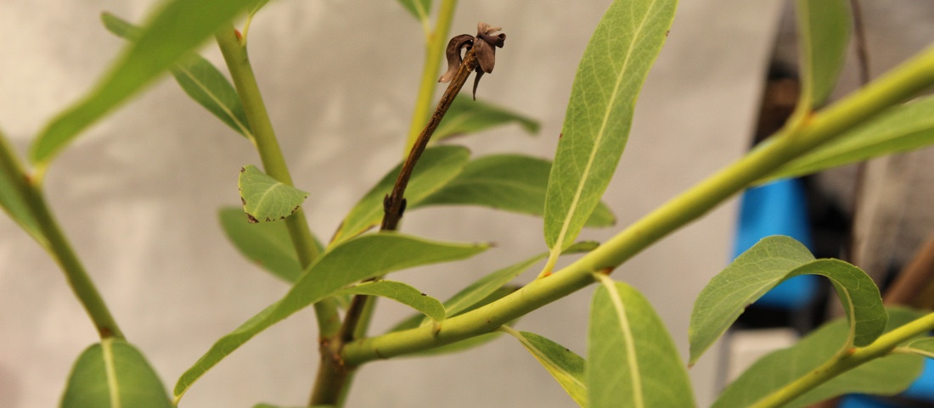

Slide 12
Effects of chilling and false spring on Phenology
Notes:
Chilling length greatly influences spring phenology during the critical budburst to leafout phases, and
thus can compensate for the detrimental effects of false springs on phenology.

Slide 13
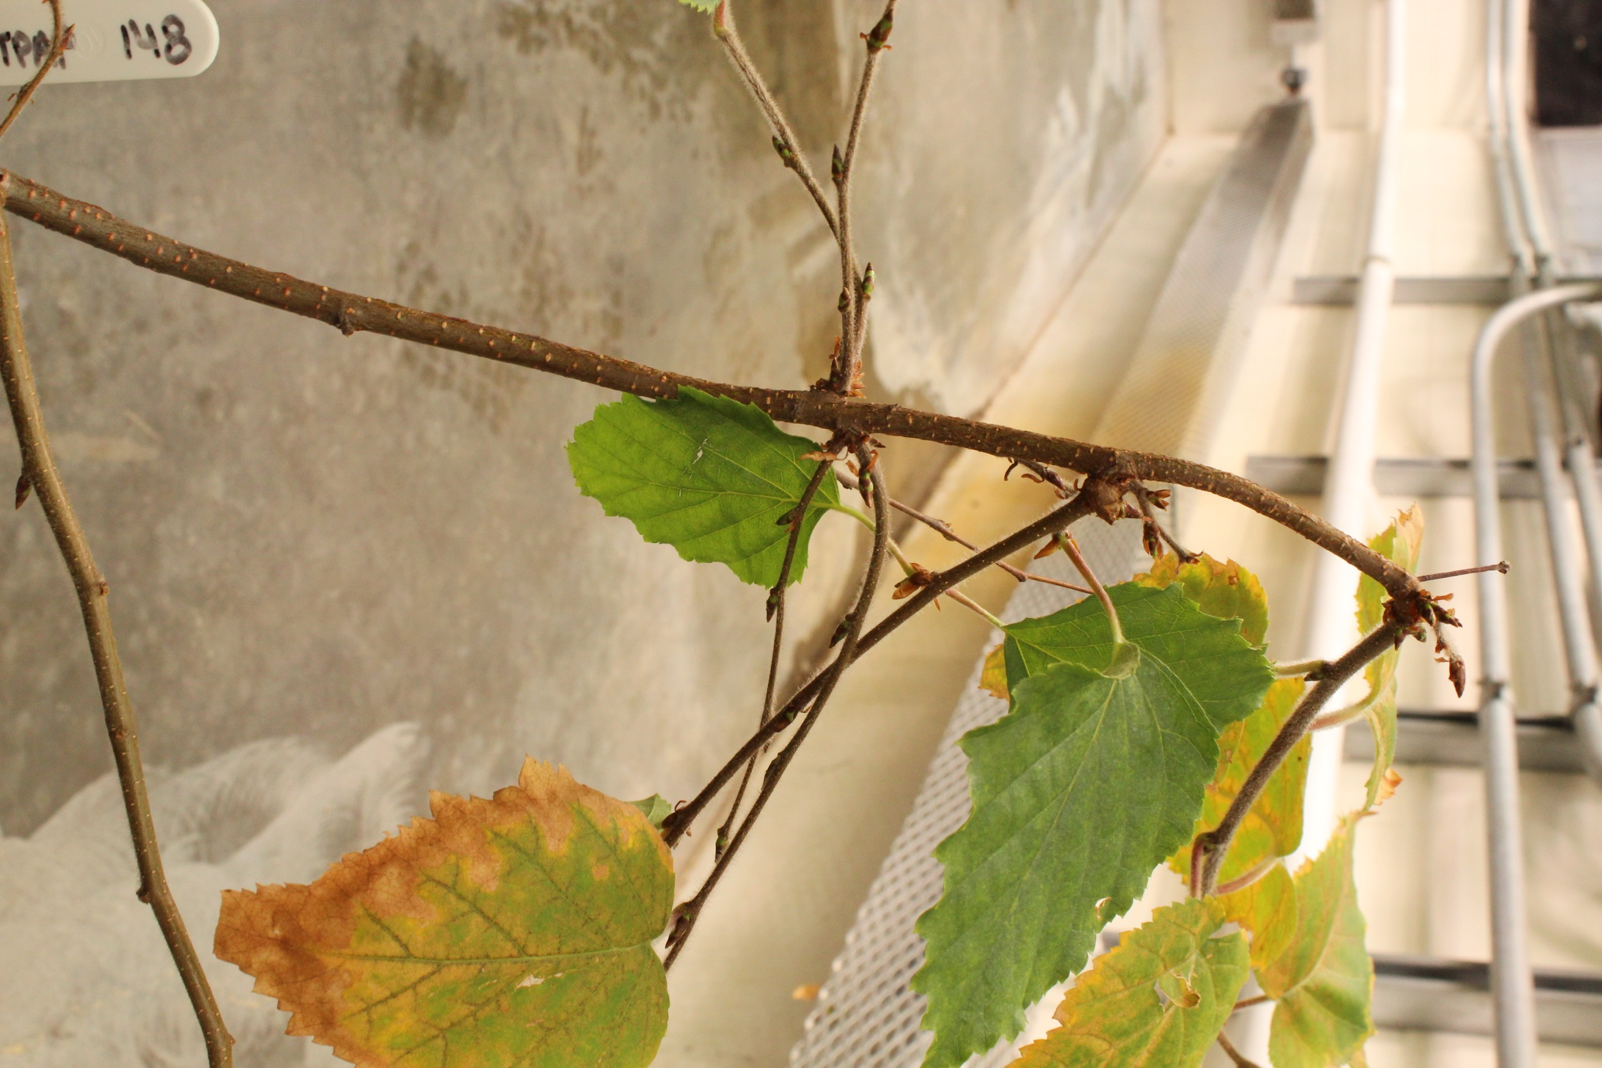
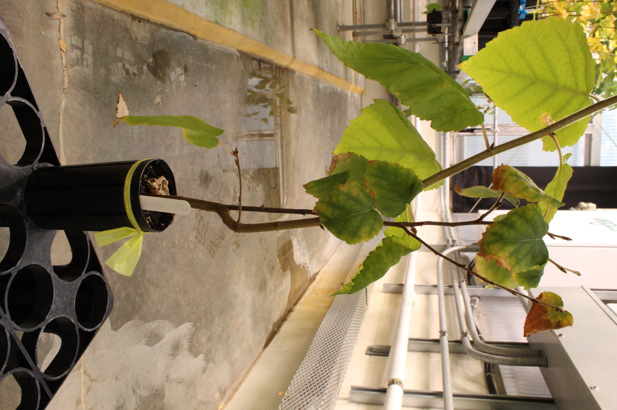
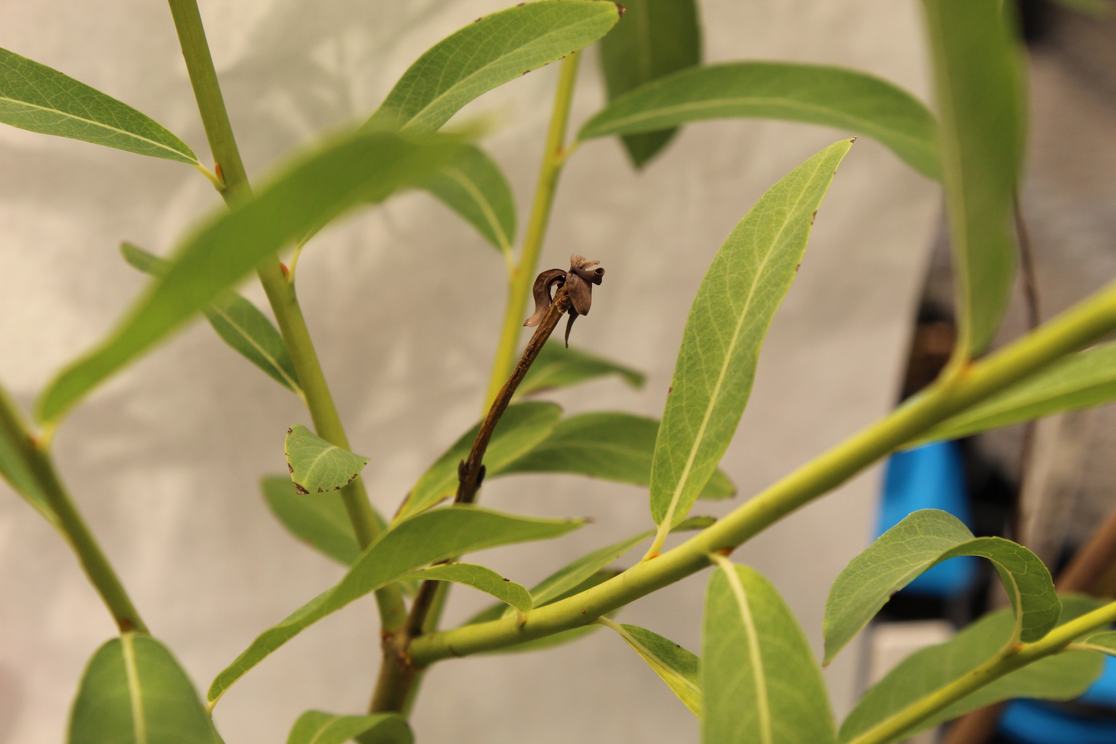
Shoot Apical Meristem Damage
Notes:
Damage to the shoot apical meristem can lead to reliance on lateral shoot growth, rendering inefficient growth patterns and—if damage is significant within a stand—it can lead to declines in recruitment

Slide 14
Effects of chilling and false spring on growth
b)

Slide 15
Effects of chilling and false spring on leaf traits

Slide 16
Phenological Rank

Slide 17
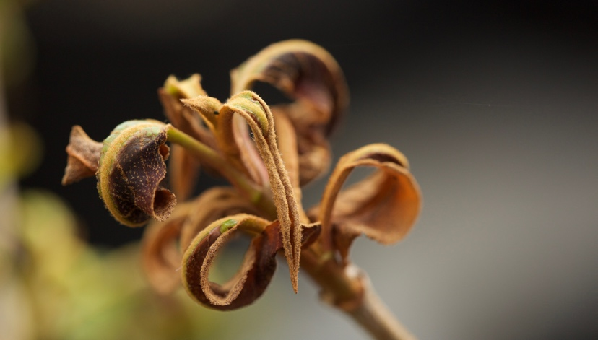
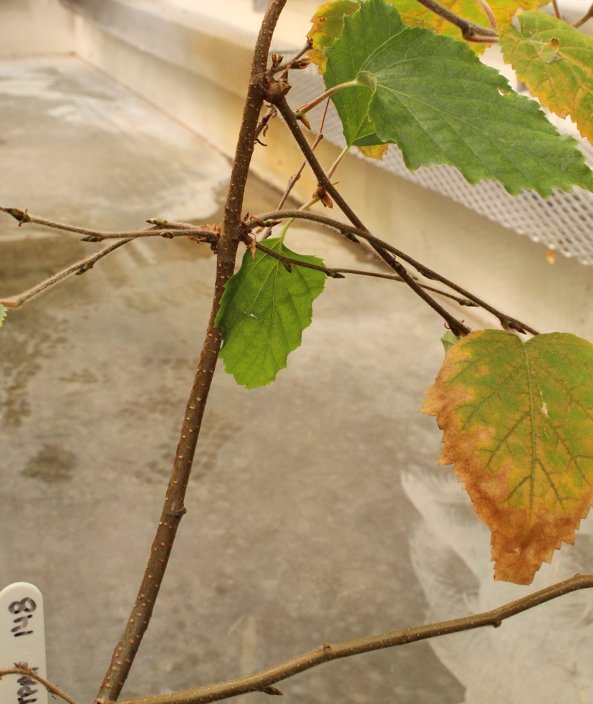
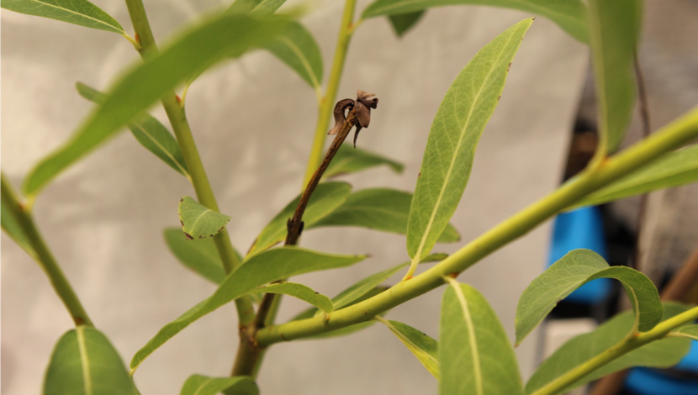
Conclusions
Duration of vegetative risk lengthens with false springs but chilling can compensate
False springs cause meristem damage and damage to leaves
Phenological rank is not changing, but communities could be reshaped from freeze damage and less chilling with climate change
Notes:
Inland individuals at higher risk
NAO: high NAO leads to higher than average winter and spring temperatures, earlier budburst

Slide 18
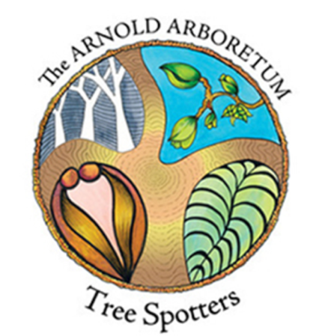

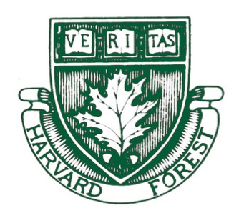




THE TEMPORAL ECOLOGY LAB
Lizzie Wolkovich, PhD
Dan Buonaiuto
Ignacio Morales-Castilla, PhD
Aileen Ettinger, PhD
Deirdre Loughnan
Darwin Sodhi
ARNOLD ARBORETUM - TREE SPOTTERS
Suz Mrozak
Danny Schissler
Kate Stonefoot
Pam Thompson
Our Citizen Scientists!!
COMMITTEE MEMBERS
Paul Moorcroft, PhD
Neil Pederson, PhD
COLLABORATORS AND SPECIAL THANKS
Iñaki Garcia de Cortazar-Atauri, PhD
Ben Cook, PhD
Kea Woodruff
Wayne Daly
Lee Toomey
Faye Rosin
Alice Linder
Dan Flynn
Alissandra Ayala
John O’Keefe, PhD
Audrey Barker Plotkin
THE HOLBROOK LAB
Noel Michele Holbrook, PhD
Fulton Rockwell, PhD
Jess Gersony
Anju Manandhar
Meghan Blumstein
Morgan Furze, PhD
Zhe He

